Slide 1
Building iOS Swift apps
5030-201720_MCS5993_M: 5030-Topics in Computer Science
5031-201720_MCS4993_M: 5031-Topics in MA/CS

Slide 2
Agenda
Continuous Integration II
Notes:
Show remarks in iTunesConnect

Slide 3
Agile Testing

Slide 4
To Do List
GUI Testing - XCUI
API Testing – Postman & Newman
Unit Testing – XCTest & Cuckoo (Mocking)

Slide 5
Continuous Integration
Jenkins!!!

Slide 6
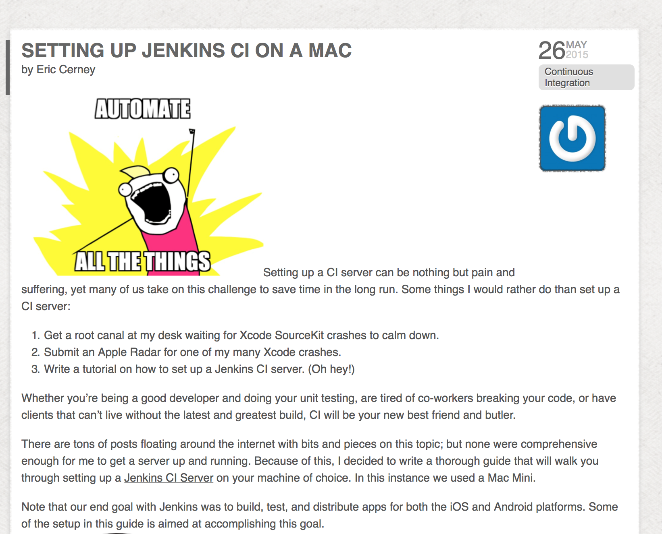
Continuous Integration
Jenkins!!!

Slide 7
Continuous Integration
http://www.cimgf.com/2015/05/26/setting-up-jenkins-ci-on-a-mac-2/

Slide 8
Sample app

Slide 9
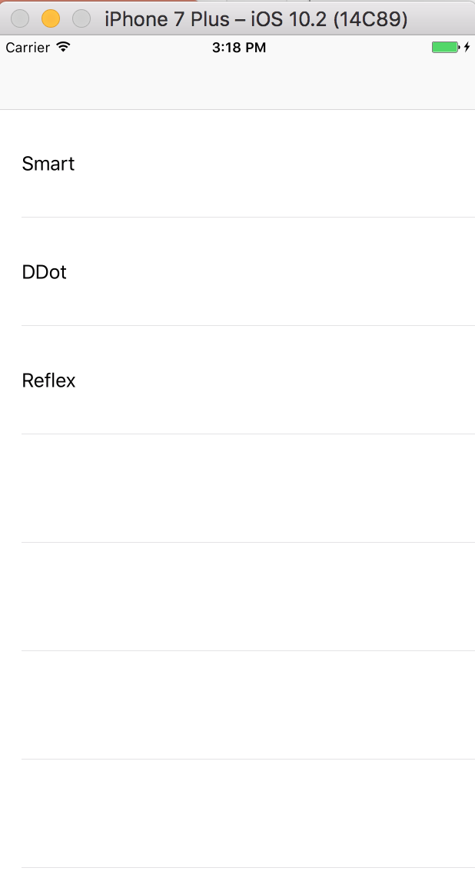
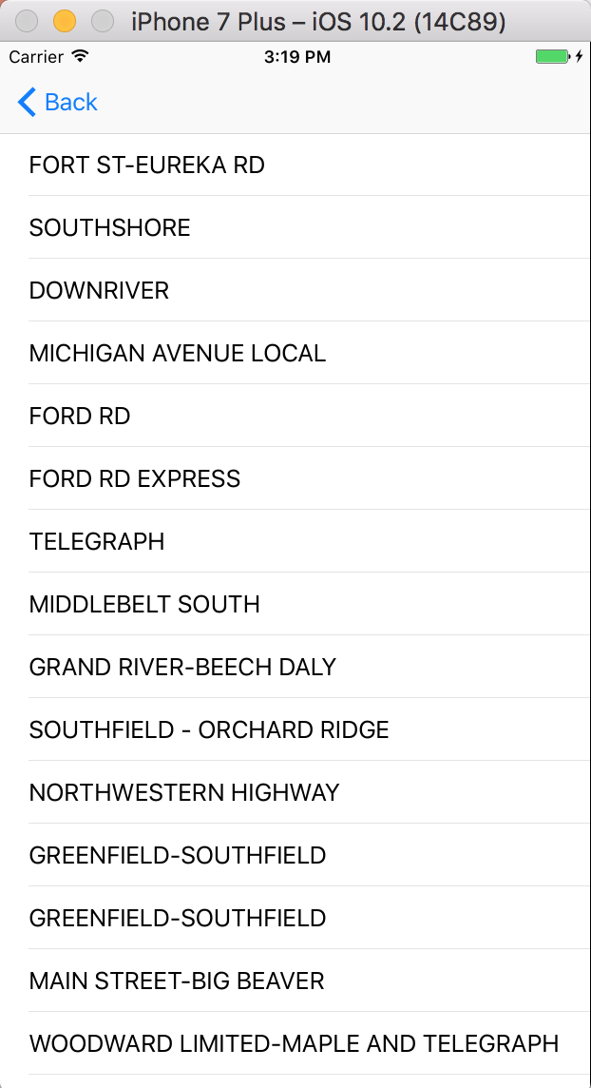
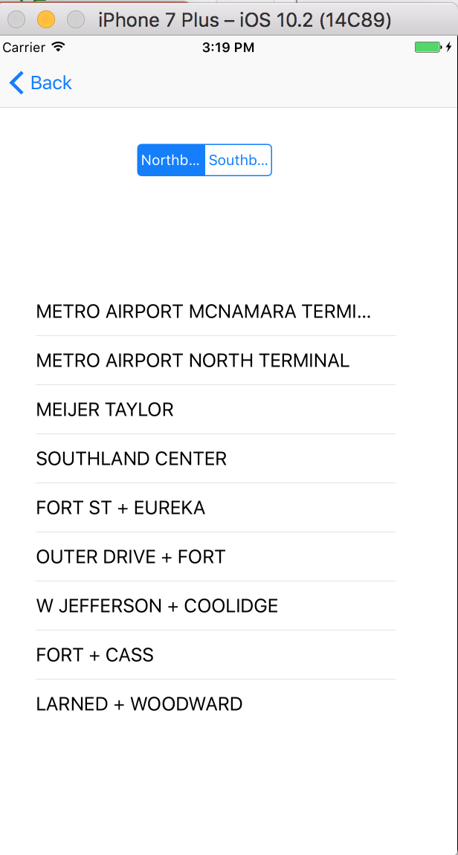
Sample app
Notes:
git clone http://github.com/dfreemanRIIS/ETAMock

Slide 10
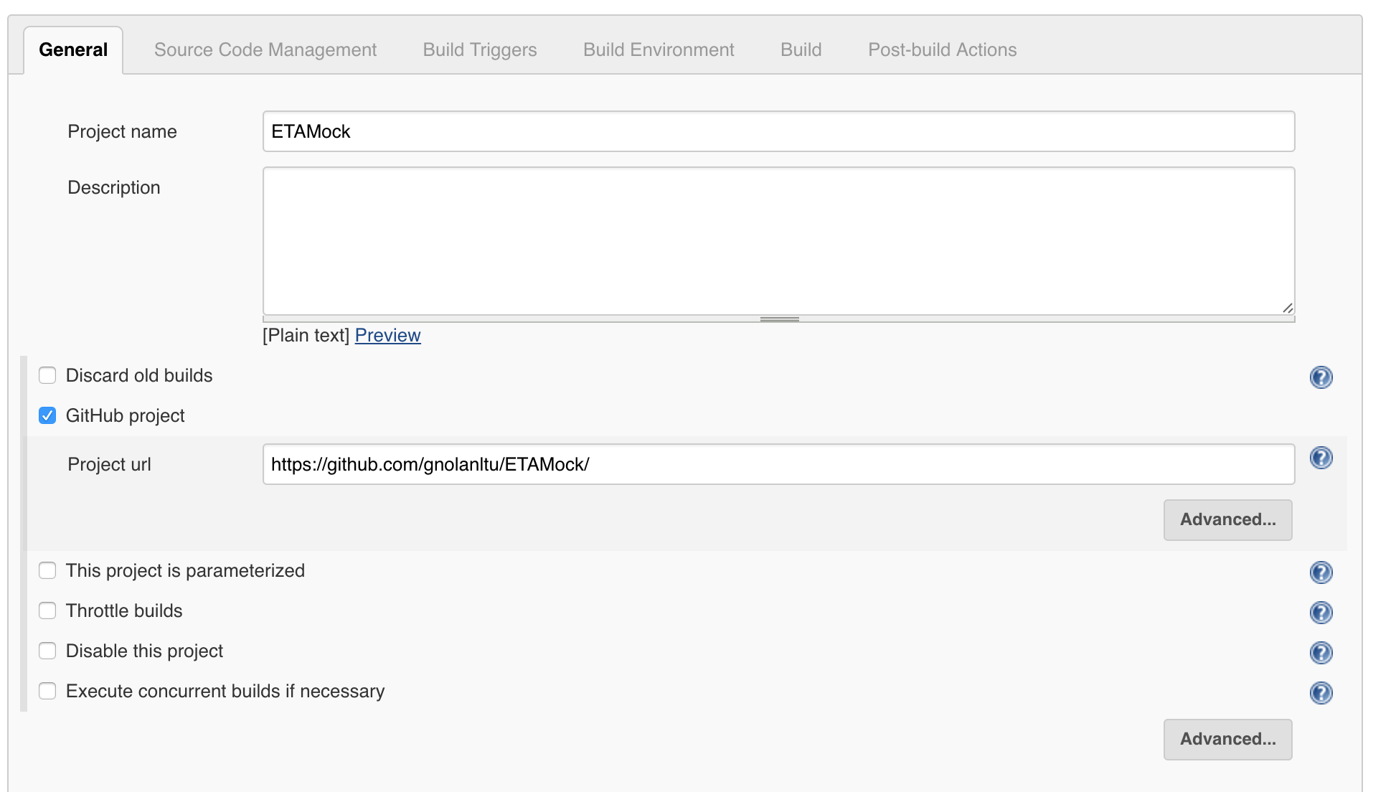
Xcode Build
Notes:
git clone http://github.com/dfreemanRIIS/ETAMock

Slide 11
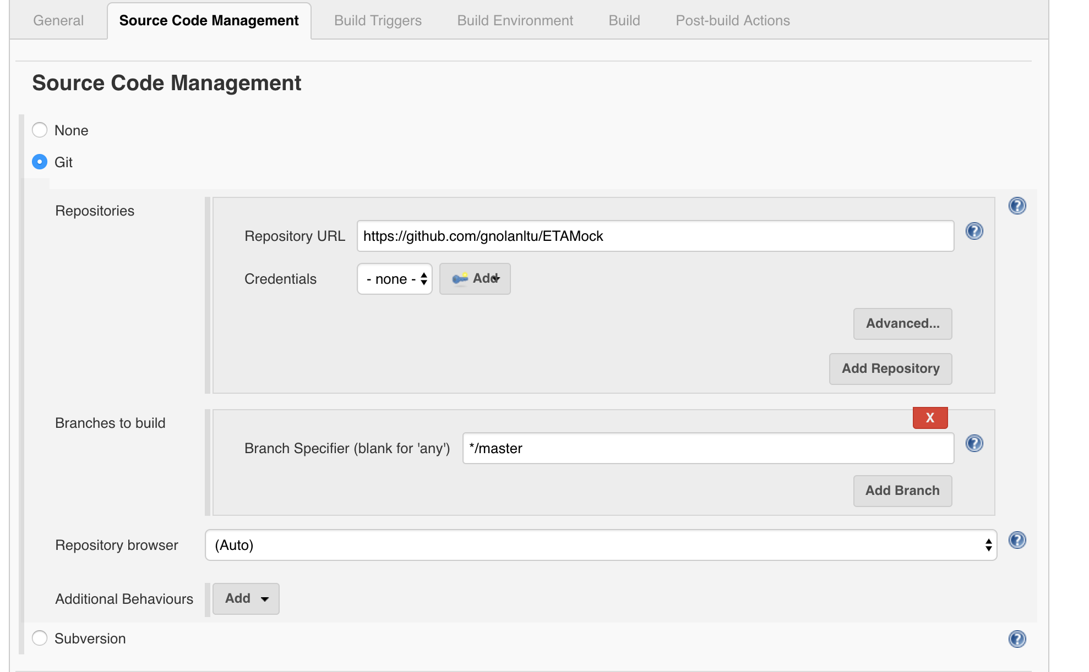
Xcode Build
Notes:
git clone http://github.com/dfreemanRIIS/ETAMock

Slide 12
Xcode Build
Notes:
git clone http://github.com/dfreemanRIIS/ETAMock

Slide 13
Commands
xcodebuild test -workspace ETAMock.xcworkspace -scheme ETAMock -destination 'platform=iOS Simulator,name=iPhone 7 Plus’ –only-testing:ETAMockTests
newman run ETAJson.postman_collection.json
xcodebuild test -workspace ETAMock.xcworkspace -scheme ETAMock -destination 'platform=iOS Simulator,name=iPhone 7 Plus’

Slide 14
Agenda Tuesday
Test Driven Development - TDD

